Slide 1
Pizza Sale Project
MySQL Presentation

Slide 2
Contents of this template
Here’s what you’ll find in this Slidesgo template:
Retrieve the total number of orders placed.
Calculate the total revenue generated from pizza sales.
Identify the highest-priced pizza.
Identify the most common pizza size ordered.
List the top 5 most ordered pizza types along with their quantities.
Join the necessary tables to find the total quantity of each pizza category ordered.
Determine the distribution of orders by hour of the day.
Join relevant tables to find the category-wise distribution of pizzas.
Group the orders by date and calculate the average number of pizzas ordered per day.
Determine the top 3 most ordered pizza types based on revenue.
Calculate the percentage contribution of each pizza type to total revenue.
Analyze the cumulative revenue generated over time.
Determine the top 3 most ordered pizza types based on revenue for each pizza category.

Slide 3
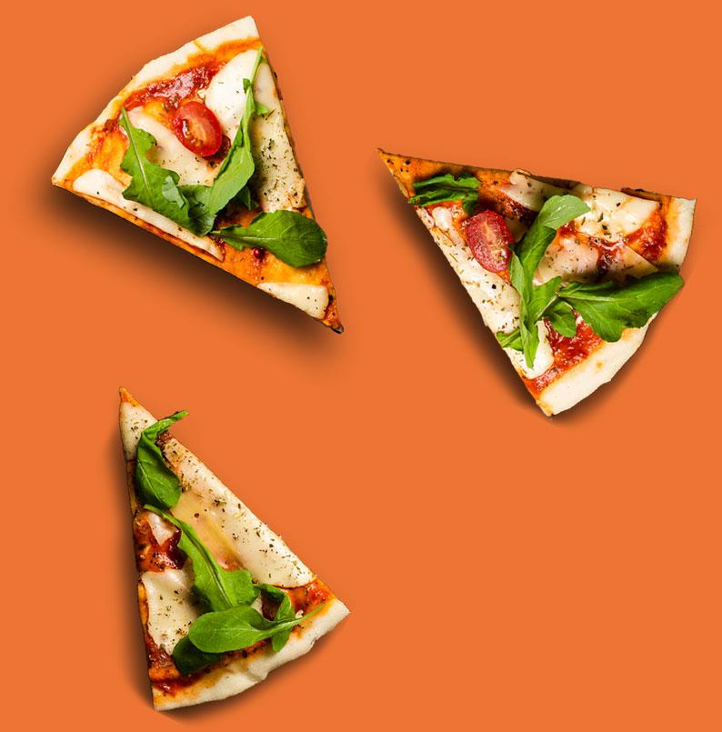
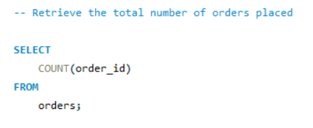
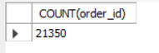
Retrieve the total number of orders placed.

Slide 4
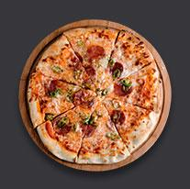
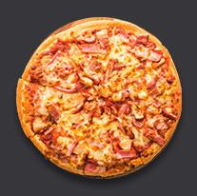
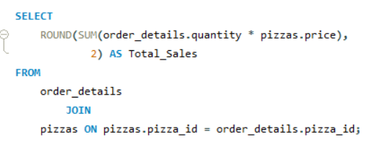
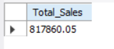
Calculate the total revenue generated from pizza sales.

Slide 5

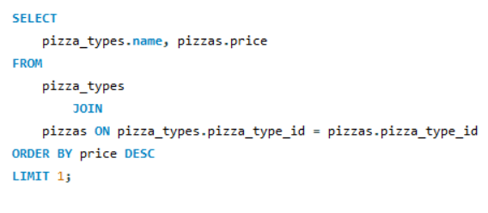
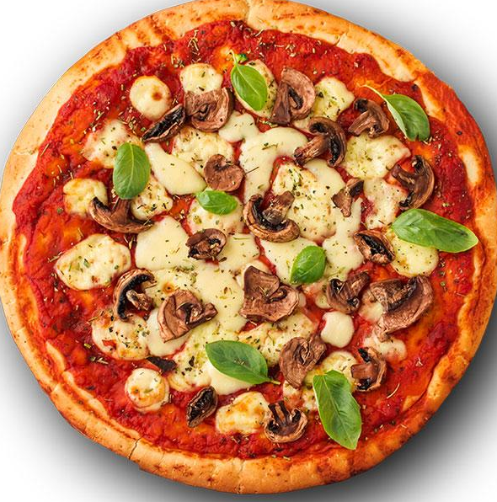
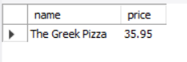
Identify the highest-priced pizza.

Slide 6
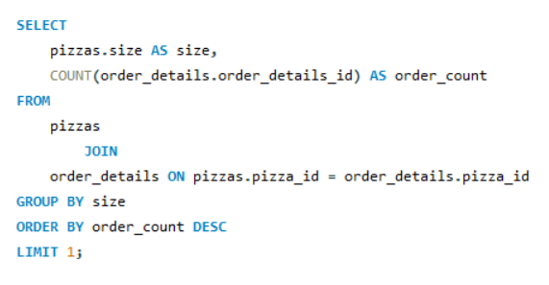
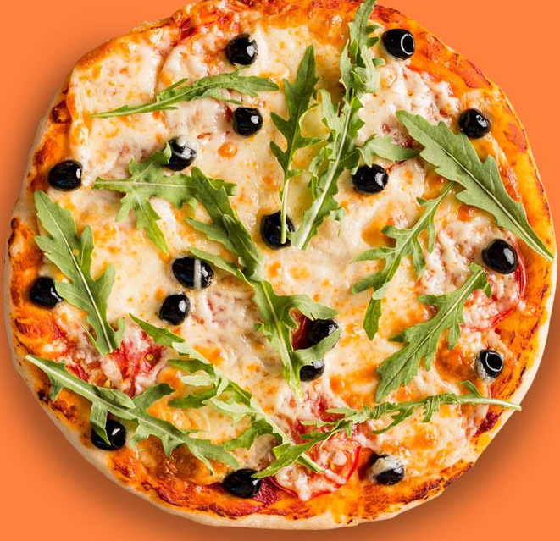
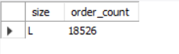
Identify the most common pizza size ordered.

Slide 7
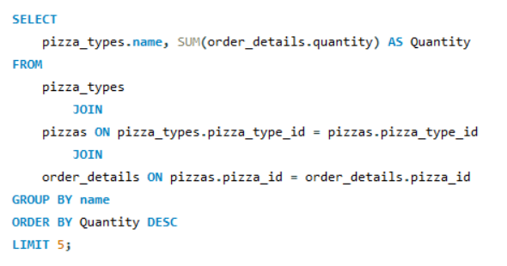
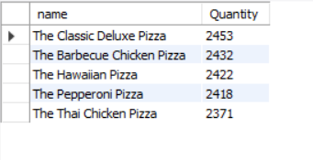
List the top 5 most ordered pizza types along with their quantities.

Slide 8

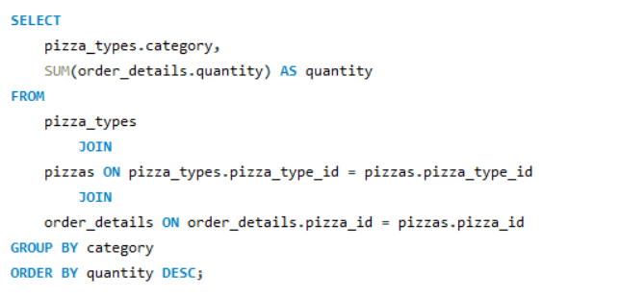
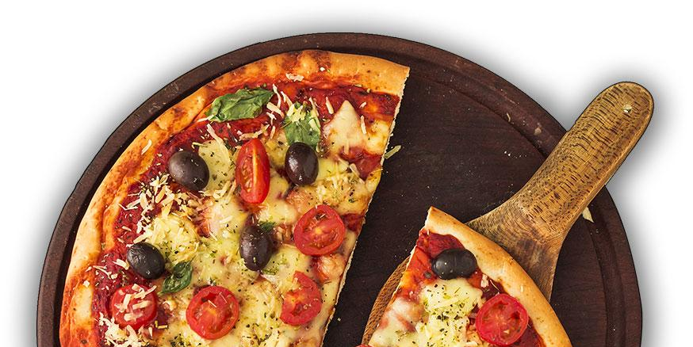
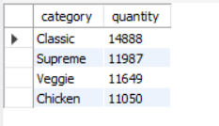


Join the necessary tables to find the total quantity of each pizza category ordered.

Slide 9
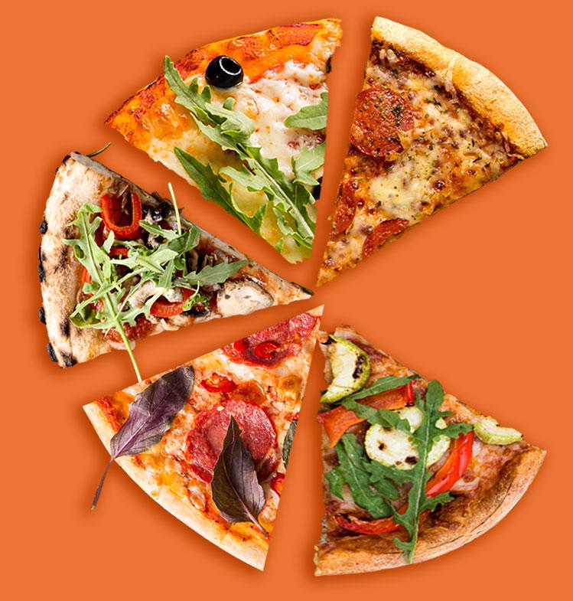
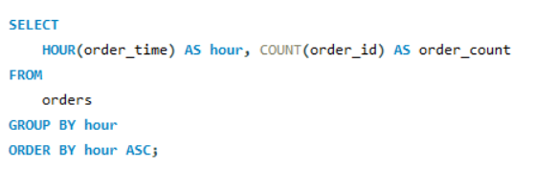
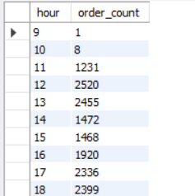

Determine the distribution of orders by hour of the day.

Slide 10
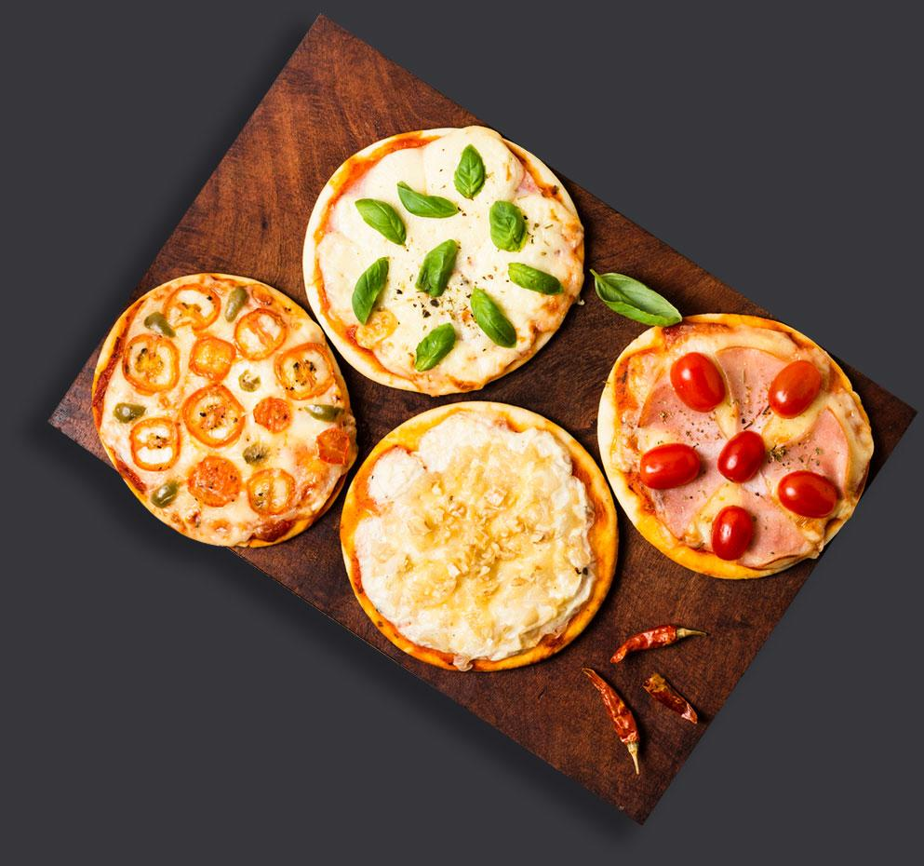
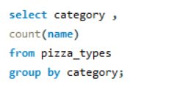
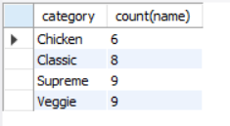
Join relevant tables to find the category-wise distribution of pizzas.

Slide 11
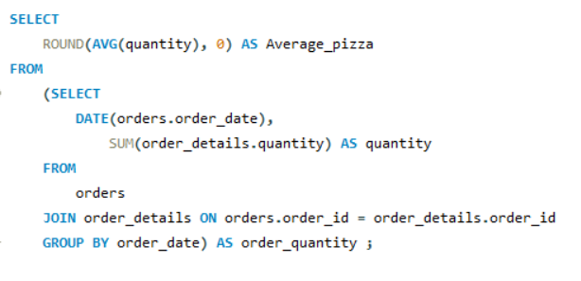
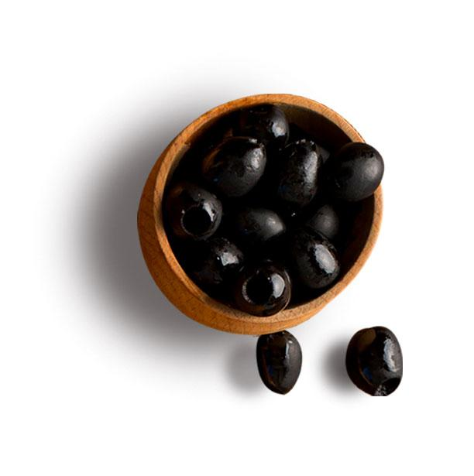
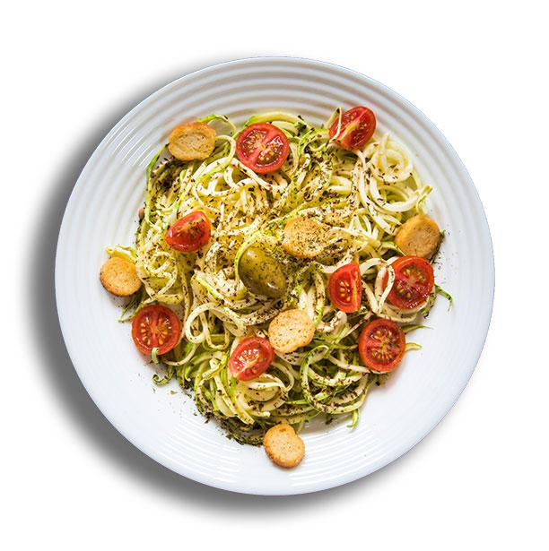
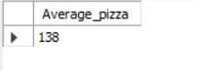
Group the orders by date and calculate the average number of pizzas ordered per day.

Slide 12
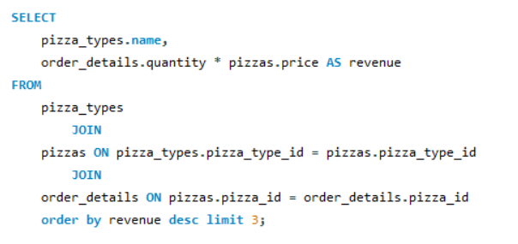
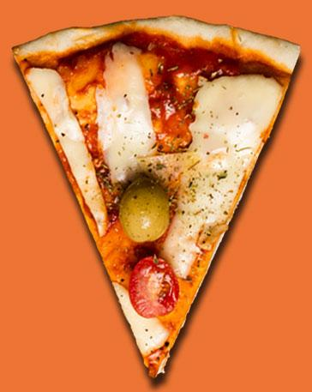
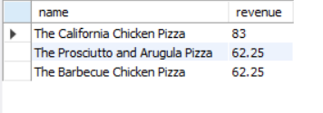
Determine the top 3 most ordered pizza types based on revenue.

Slide 13
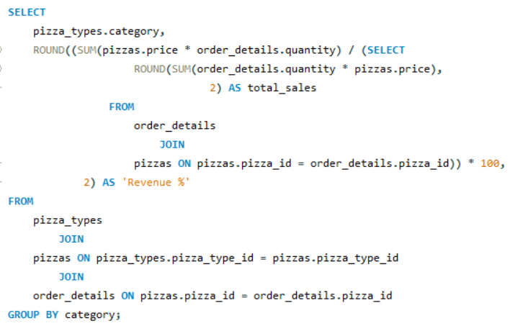
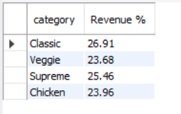
Calculate the percentage contribution of each pizza type to total revenue

Slide 14
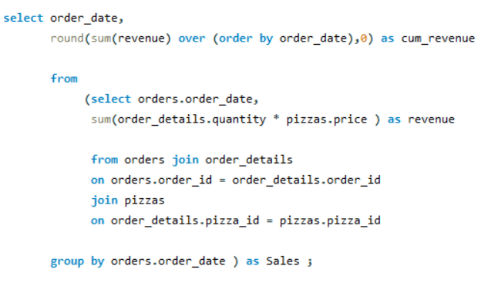
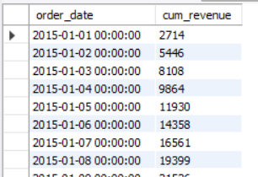
Analyze the cumulative revenue generated over time

Slide 15
Resources
VECTORS:
Italian food banner theme
Moody restaurant food menu mock-up
Menu for traditional italian food restaurant
Menu template for pizza restaurant
Italian food landing page
Poster template for pizza restaurant
Delicious pizza horizontal banner template
Pizza poster template
Flyer template for pizza restaurant
Pizza restaurant template banner
Pizza flyer template concept
Italian food poster template
Pizza restaurant ad template banner
Pizza restaurant square flyer template with photo
Horizontal banner template for italian food restaurant
Vertical flyer template for italian food restaurant
Italian restaurant ad square flyer template
Italian food landing page
Italian food poster template
Poster template for traditional italian food
Pizza restaurant landing page

Slide 16
Resources
PHOTOS:
Delicious italian pizza on wooden table
Delicious pizza concept with copy space
Top view delicious pizza slices
Delicious pizza concept with copy space
Top view pizza with red pepper and tomato sauce with copy-space
Close-up view of pizza on wooden table
Tasty traditional pizza arrangement
Top view wine bottle and glass with grapes and copy-space
Full bottle of red wine and empty glass
Delicious pizza concept with copy space
Top view of delicious pizza concept
Tasty appetizers with cheese plate, tomatoes and grapes
Top view dairy products
Grilled margherita pizza with tomato sauce; cheese; basil and mushroom

Slide 17
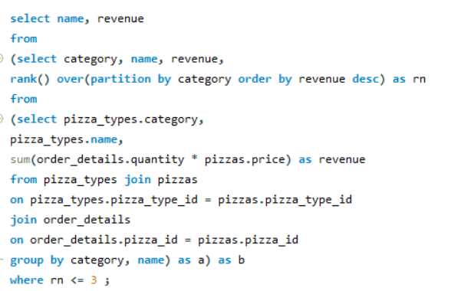
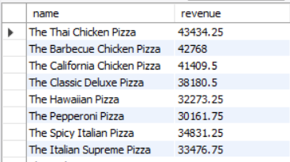
Determine the top 3 most ordered pizza types based on revenue for each pizza category

Slide 18
Thanks!
Downloaded from
BhupeshPandey01 (Bhupesh Pandey) (github.com)

